Slide 1
Adventure Works Group
Data Science Project Presentation
By Ifeanyi Innocent Ugwu
For Pairview Consult UK

Slide 2
Table of Content
Objectives
Methodology
Approach
Dashboard
Recommendation System
Churn Predictive Model
Commercial Benefit
Recommendation

Slide 3

OBJECTIVES:
To develop an automated report system that will be creating a stream reporting solution that will deliver analytics.
The reporting dashboard can show daily, monthly quarterly and yearly sales performance by regions, products, subcategories categories and demographics.
Build a recommendation engine solution, that will automatically recommend a product to a customer based on their purchase history
To develop a predictive model to automatically notify AHG leaders 90 days before a customer is due to churn, using 8 months as a baseline to become a churner.

Slide 4
Methodology:
Recommendation Engine
Churn Model
Dashboard
Data was script from SQL server in live connection
Incorporated Microsoft PowerBI to hence analytics visibility for proper analysis
Data sourced from SQL server
Collaborative model was deployed.
Turicreate library was used to build the model
Database was joined using python code
Unsupervised Technique
Supervised Technique
Variable Selection
Cross Validation
Model Selection
Scoring New Data
Data Cleaning

Slide 5

Approach

Slide 6
Dashboard
Microsoft PowerBI was chosen for this dashboard development
Data was moved from SQL server using direct Query option
A comprehensive SQL script was written to bring in six tables together
Some featuring engineering were done using SQL code like Profit column.
Data was cleaned properly prior loading
DAX formula was applied to get year, month etc.
Age Band was created, and name as indicated below:
Age_Band:
0 - 40=Youth
41- 50 = Adult
>51 = Senior Citizen

Slide 7
Dashboard
Microsoft PowerBI was chosen for this dashboard development
Data was moved from SQL server using direct Query option
A comprehensive SQL script was written to bring in six tables together
Some featuring engineering were done using SQL code like Profit column.
Data was cleaned properly prior loading
DAX formula was applied to get year, month etc.
Age Band was created, using conditional formating:
Age_Band:
0 - 40=Youth
41- 50 = Adult
>51 = Senior Citizen

Slide 8
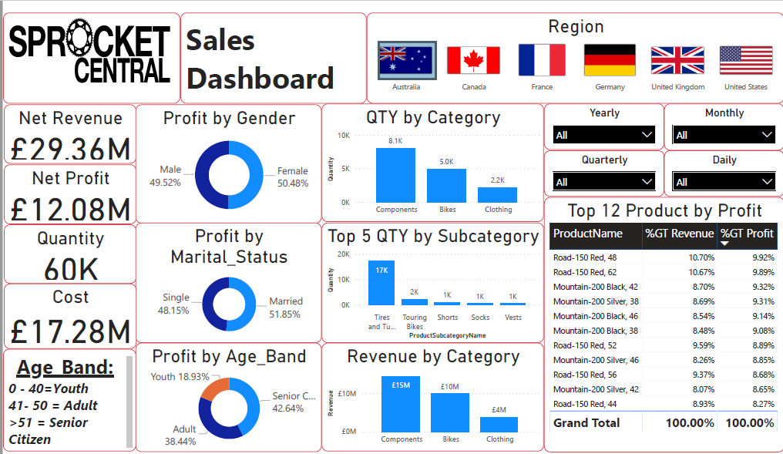

Slide 9

Recommendation Engine

Slide 10
Recommendation Engine
Majority of the research online on recommendation engine were done using rating, very hand full of them have order quantity.
Purchase dummy was created to monitor the buying attitude of the customers.
Before running a more complicated models like Collaborative Model, a baseline was developed for comparison and evolution of models.
Turicreate library was used to define models
OrderLineNumber was used to see the interaction in sales in other to get similarities in customers taste.

Slide 11
Recommendation Engine
80% of data set was used to training the model and 20% for test.
The popularity model takes the most popular items for recommendation.
Training data is used for model selection
For evaluating recommendation
engines, the concept of RMSE
and precision-recall was applied.
1,120 Recom Products
18,484 Customers

Slide 12
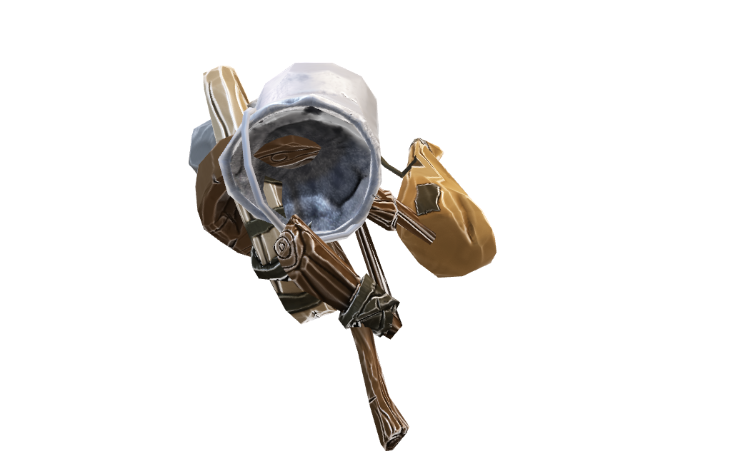
Create Dummy
Dummy for marking whether a customer bought that item or not.
If one buys an item, then purchase
dummy are marked as 1

Slide 13
Popularity
No Item Personalization
Ineffective for this Project
Collaborative Filtering
Better Algorithm
Recognize Customers Uniqueness
Precision and Recall
Poor Recommendation Score
Recommendation Favors Dummy
Better Model
Poor Model
Evaluation Summary

Slide 14
EVALUATION SUMMARY
RMSE
Cosine
Mean Square Error

Slide 15
Churn Prediction Model

Slide 16
Churn Model Method
All Customers 18484
Churners(1) 30.3% (5608)
Non-Churners (0)
69.7% (12876)

Slide 17
RFM Calculation
RFM was used to get customer live time value:
- Recency = Orderdate
- Frequency = OrderQuantity
- Monetary = TotalSum
R
Recency
F
Frequency
M
Monetary

Slide 18
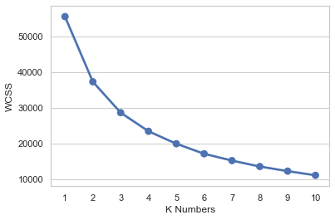
Customer Segmentation with K-Means
So we need to choose the optimized number, and the Elbow method is one of the solutions where we can get the hints.
Customers were segmented into three clusters

Slide 19
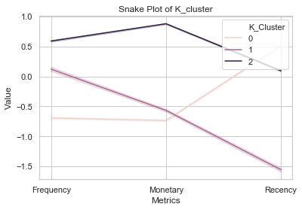
Customer Segmentation with K-Means
For easy comparison of the RFM, snake map and heatmap was used
Cluster 2 delivered the highest revenue which makes it more profitable.

Slide 20
Model Development
Non-Churners
69.7% becomes 100% (12876)
Train, Test or Validate a predictive model of your choice using this data. This is where we apply data partitioning rules
Hold Out Data
6438 (50%)
Churners 30.3%(5608)
Non- Churners
6438 (50%)
Historic Data

Slide 21
Data Splitting
Total Customer
This is the total number of customers .
6,438
Hold Out Data/ Test
50% of Non-Churners dataset. This is what would be used for testing
Train Data
This is the combination of 50% of Non-Churners and 30.3% of Churners making up for our train dataset.
12,046
18,484
5,608
Churners
30.3% of the whole dataset.

Slide 22
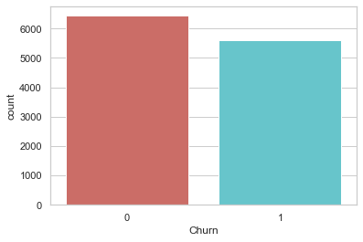
Distribution of the Target Variable
Churners = 1 and Non Churners = 0

Slide 23
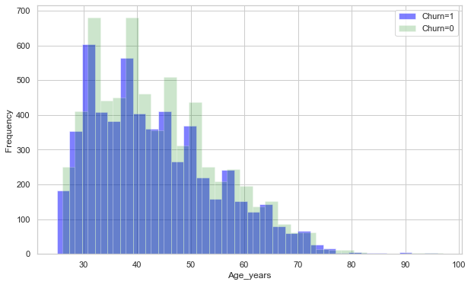
Age Distribution vs Churn
Comment:
Most of the customers in this dataset are within the age bracket of 30 and 50.
Meanwhile, the churners are in 30 and 40 years of age.

Slide 24
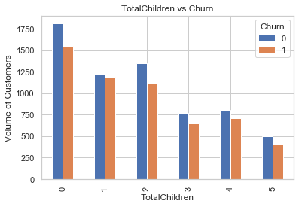
Churn Visualization
Comments:
Customers without children has the propensity to churn
Chunk of the customers are clouded in none children customers

Slide 25
Variable Selection – Vote Based Approach
Weight of evidence and Information Value
Variable Importance using Random Forest
L1 feature selection
We are going to use regularisation to add penalty in every parameters in the machine learning model, the reason for this is to eliminate overfitting in the model.
Recursive Feature Elimination
Variable Importance using Extratrees Classifier
Chi Square
We will use chi square to determine which of the features are very relevant to the outcome that will be predicted and remove those that are unimportant for this model
Extratrees classifier perform similarly to RandomForest, the only major difference is the level of variance, of course extratrees show the lowest variance.

Slide 26
Model selection
The model with the best accuracy will be selected, RandomForestClassifer has 99.40% accuracy which makes it the model for the project
99.40%
55.95%
53.41%
57..26%
67.18%
RandomForestClassifier
Naive Bayes
Neural Network
Logistic Regression
Gradient Boosting
www.free-powerpoint-templates-design.com

Slide 27
Possibly Future Churners
Possible Churners
Possible Retain
.
55.8%
44.2%

Slide 28

Commercial Benefit

Slide 29

If 70% of Recommended Items were Sold
We had 18,484 customers with 1,120 products recommended to these various customers based on previous behaviours towards the products.
If 70% (784 products) of this products recommended are ordered AHG will grow sales by over 100% thereby increasing revenue and profitability.

Slide 30
Top 3 Customers with Average Recommendation
Customer ID | Full Name | Average Recon Product | $ Revenue
11000 | John V. Hang | 11 | 330,787
11001 | Eugene L. Huang | 14 | 550,007
11002 | Ruben Torres | 9 | 407,898
Avg Revenue $1,288,692
John $330,787
Eugene $550,007
Ruben $407,898
With an Average of 34 product the revenue increased

Slide 31
Churn is Great Revenue Denier
Commercial Impact of Churn to AHG revenue
Customer Average Purchase * Quantity * Churn Propensity
$12,571,874 of the whole dataset

Slide 32

Business Recommendations

Slide 33
Recommendation Engine
Revisiting of recommendation engine and carry out test repeatedly make sure that collaborative model is still maintain its relevance over popularity model
Subject to improved result integrate recommendation on online retail platform to flag top three recommendation to each customers
Tightly integrate with marketing team aimed to lure customers with high propensity to churn
Customized email/SMS for failed or incomplete transactions for all online
prospects.
Customized email/SMS for failed or incomplete transactions for all online
prospects.

Slide 34



Churn Predictive Model
Look at product summary per customer as against transaction summary (e.g maximum number of product purchase per order and per customer).
Perform A/B test on holdout scores from churn model. Split the groups into two equal predicted churns and customers retained and push messages to one group. This should be integrated to recommendation engine logic.
Perform A/B test on holdout scores from churn model. Split the groups into two equal predicted churns and customers retained and push messages to one group. This should be integrated to recommendation engine logic.

Slide 35
Conclusion
We expect a great progress and quick change in market penetration and revenue in online shops.

Slide 36
THANK YOU

